Slide 1

Integrating Semantic with Keyword Product search in Online Marketplaces
By: Roberto Piran Amedi & Albin Rönnkvist

Slide 2
Overview
Introduction
Literature Review
Results and Discussion
Proposed Solution
Conclusions and Future Recommendations
Questions

Slide 3
Introduction
Importance of online marketplaces and product search

Slide 4
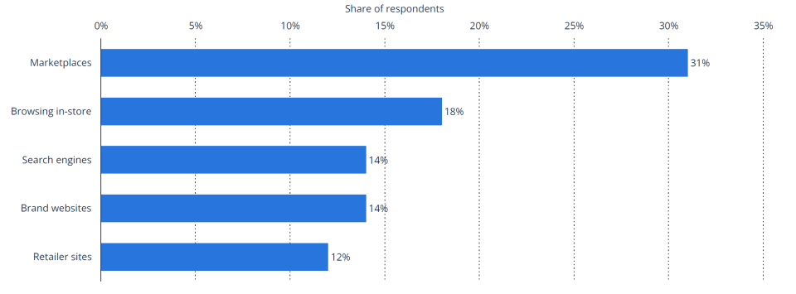
Introduction | Online Marketplaces
Online marketplaces are popular platforms for finding products
2023 International Trade Administration Survey: Online marketplaces are the main starting point for product searches worldwide

Slide 5


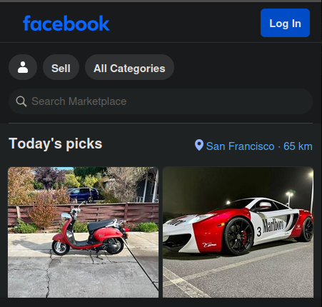
Introduction | Product Search
The search bar is a widely used tool for finding products
2022 Google Survey: 7 out of 10 shoppers use the search bar as the primary method

Slide 6
Introduction
Current state and challenges of product search

Slide 7
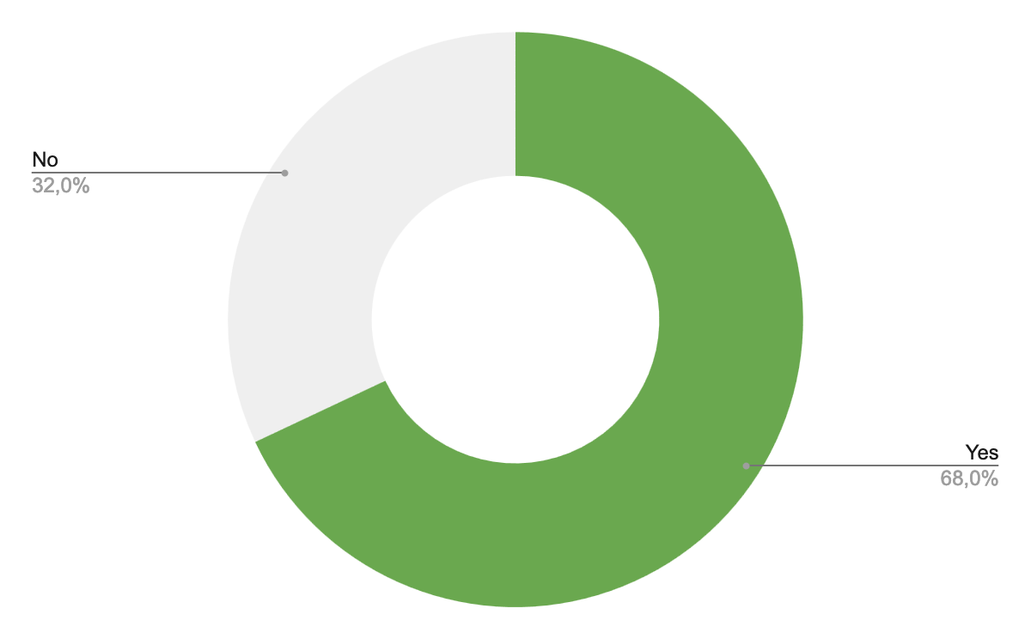
Introduction | Current State
There is widespread dissatisfaction with search results among shoppers
2022 Google Survey: Only 12% of shoppers find exactly what they are searching for when using the search bar
Results in $2 trillion in annual losses globally
2024 Constructor Survey: 68% of shoppers want improved search results

Slide 8
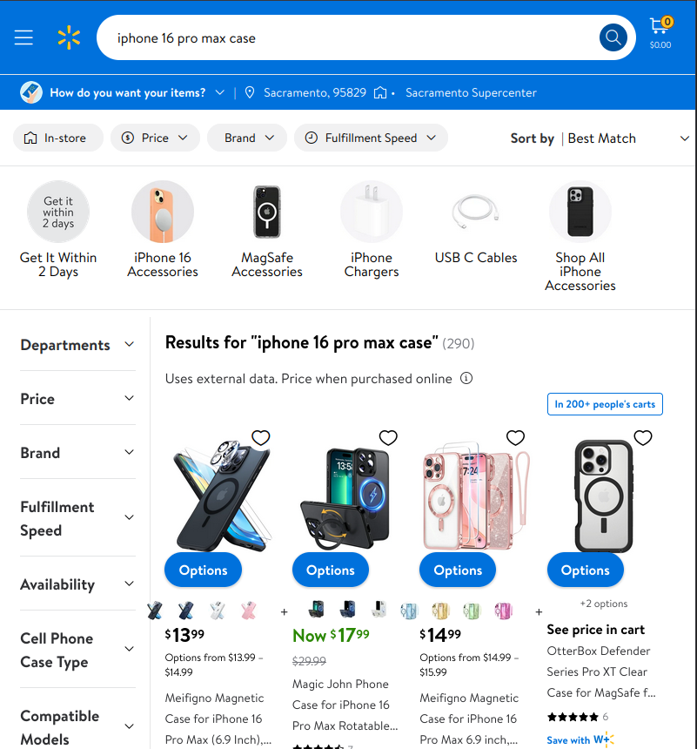
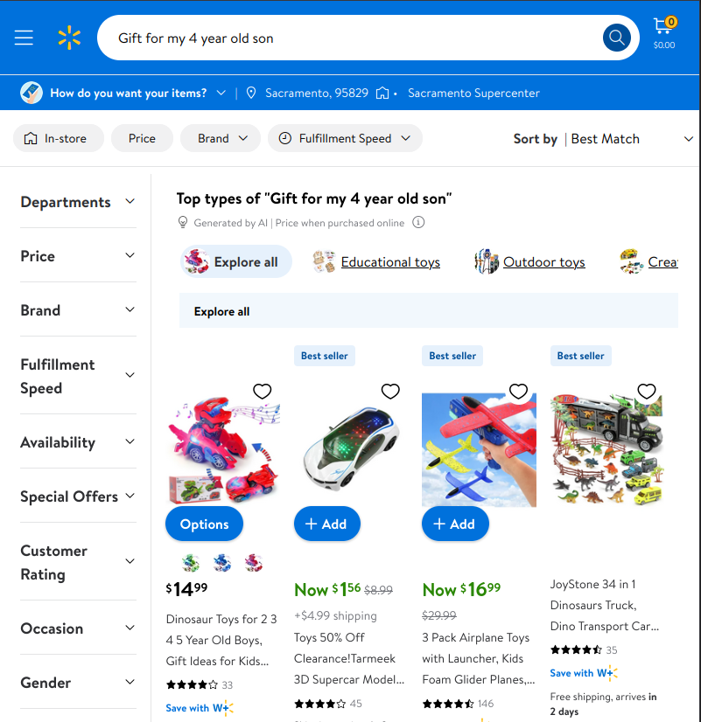
Introduction | Challenges
Diverse user intentions

Slide 9




Introduction | Challenges
Experienced computer user
Diverse user base
Language and culture
Backgrounds and expertise
Formulating queries
Formulating product descriptions
Inexperienced computer user

Slide 10
Introduction
Common product search systems: keyword-based, semantic-based, and hybrid

Slide 11
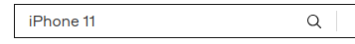


Introduction | Keyword Search
Word matching
Main strength: Precise matching (e.g., model numbers and brand names)
Limitations:
Lacks understanding of context and underlying intent
Struggles with vocabulary gaps (e.g., misspellings and synonyms)

Slide 12



Introduction | Keyword Search
Human interaction
Eye pads are not devices.
They likely meant 'iPad' but misspelled it.
I want to buy an
eye pad device
Sure, I’ll show
our iPads
Keyword-based search system
eye pad device
I want to buy an
eye pad device
Sure, I’ll show
our eye pads

Slide 13
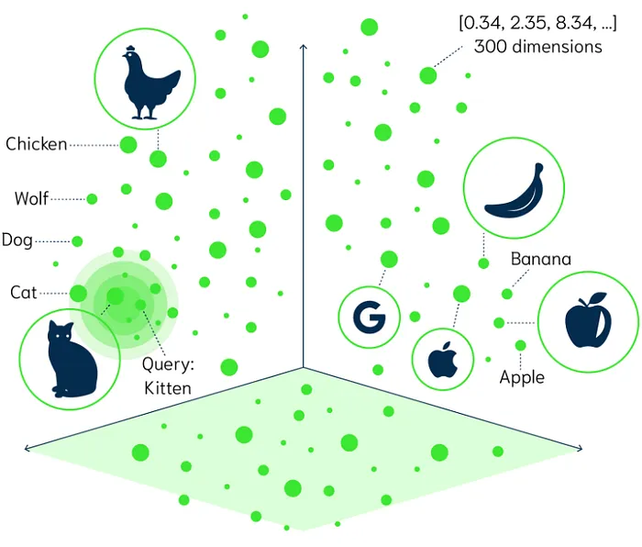

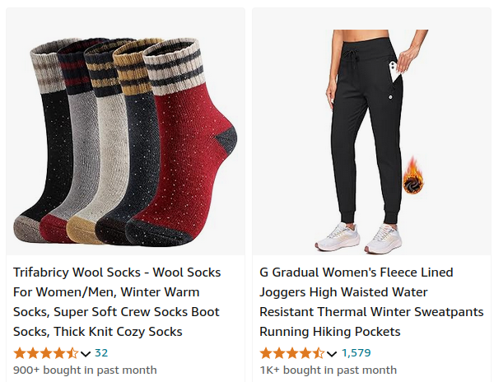
Introduction | Semantic Search
Matching based on the intent and contextual meaning
“Product / query” -> Embedding model -> [0, 7, 2, …]
Captures semantic meaning
Measure distance or similarity
Main strength: Understands the underlying meaning, beyond just words
Limitations:
May produce inaccuracies when specific terms are important (e.g., model numbers)
Other known limitations, such as negations and units of measurement

Slide 14

Introduction | Hybrid Search
Combines keyword and semantic search
Complementary:
Precise term matching
Underlying meaning
Hybrid
Semantics
Keywords

Slide 15
Introduction
Research Questions

Slide 16

Introduction | Research Questions
Hybrid Architectures: How can hybrid models be implemented to utilize the capabilities of both keyword and semantic models?
Hybrid Search Impact on Product Search Results: What is the impact of hybrid models on product search results compared to keyword and semantic models used independently?

Slide 17
Literature Review
Selected studies, hybrid architectures and their impact on product search results

Slide 18
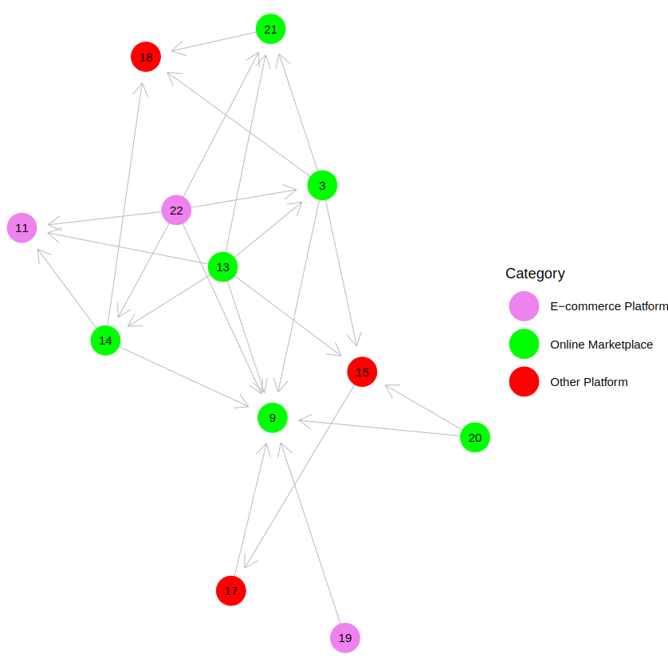
Literature Review
Selected studies:
6 online marketplaces
3 e-commerce platforms
3 other platforms
Includes:
Hybrid models
Offline and online experiments
The studies are interconnected

Slide 19
Results and Discussion
Hybrid architectures and their impact on product search results

Slide 20
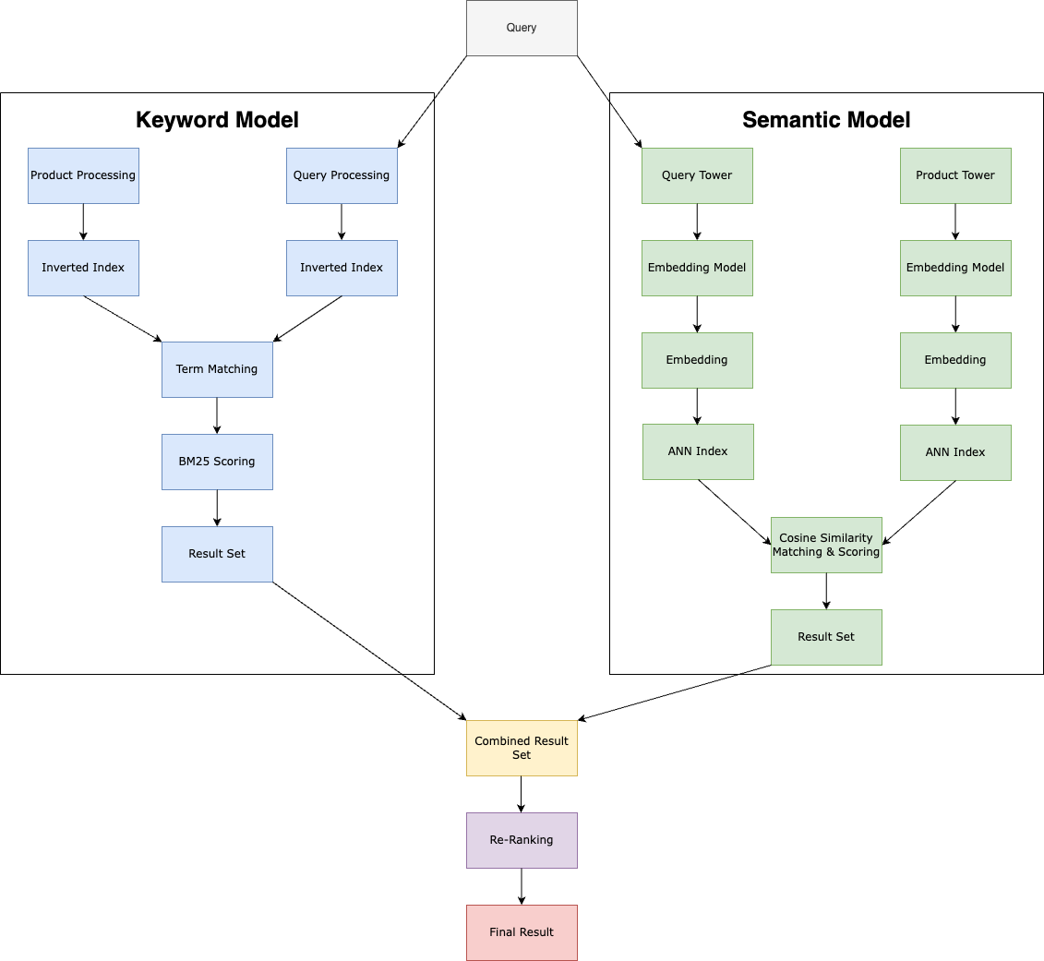
Results and Discussion | Hybrid Architectures
Differences between hybrid models, but similar foundation
Core Keyword Models:
Inverted index term matching
BM25 scoring
Integration of Semantic Models:
Two-tower architecture with query and product embeddings
Approximate Nearest Neighbor (ANN) search with cosine similarity for matching and scoring
Hybridization:
Merging: Combines results from both models into a unified match set
Re-ranking: Following this merging, refines and ranks matches based on relevance (limited re-ranking details available across studies)

Slide 21
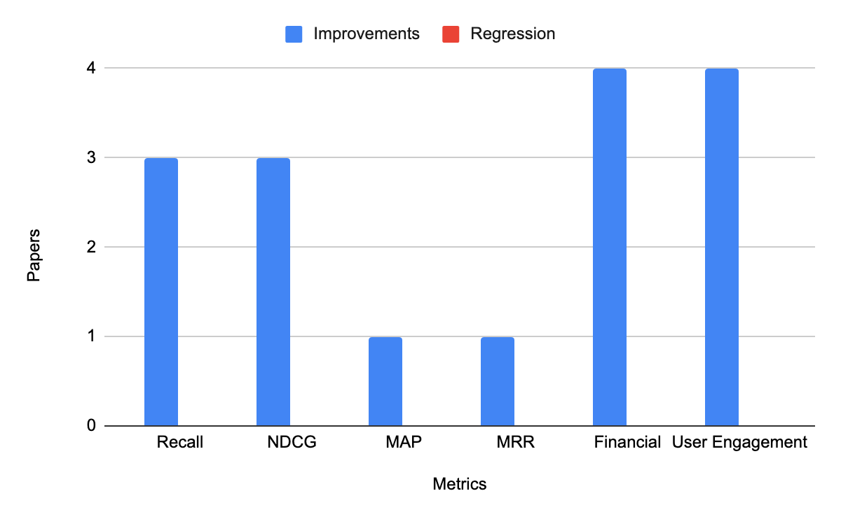
Results and Discussion | Impact
Significant improvements in product search result metrics when compared to standalone models
Improved coverage, ranking quality and business performance

Slide 22
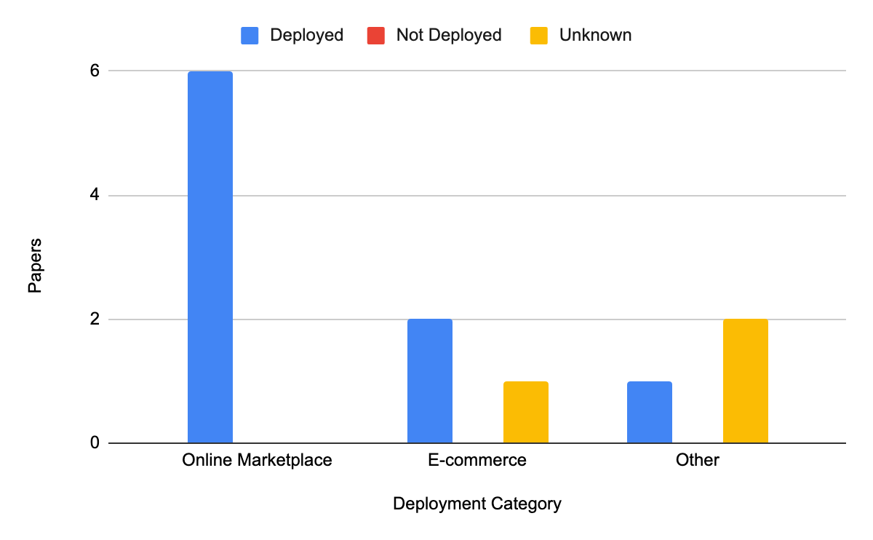
Results and Discussion | Impact
A majority of hybrid models were deployed in production

Slide 23
Proposed Solution

Slide 24
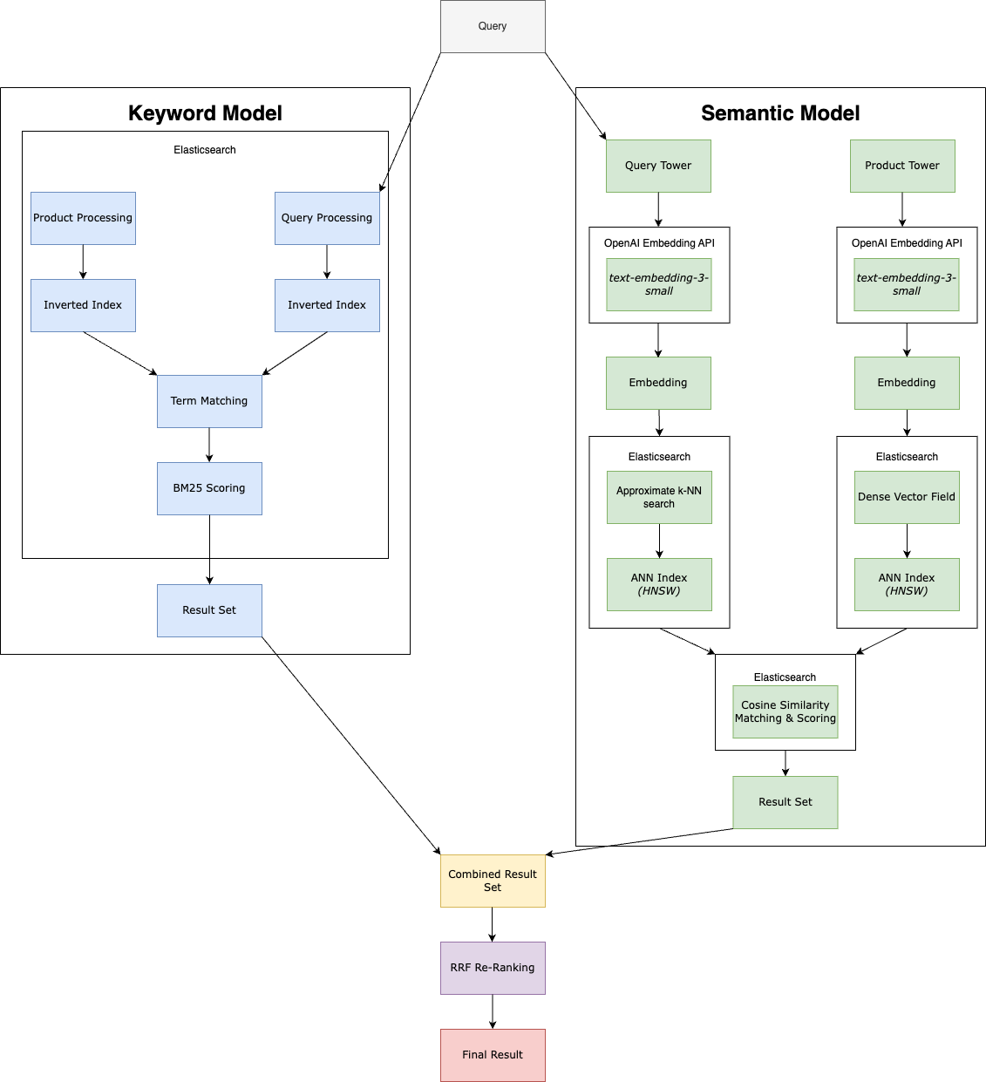
Proposed Solution
Hybrid models provide better product search results
Hybrid models can be complex to implement
Requires expertise and resources
Proposed solution: A simplified hybrid model for broader adoption
Inspired by models in the review
Lightweight and flexible
Codebase

Slide 25
Conclusions and Future Recommendations

Slide 26
Conclusions and Future Recommendations
Discussed different hybrid architectures and identified a similar foundation across the literature
Multiple studies, with various experiments and metrics, verified that hybrid models significantly enhance product search results
We proposed a simplified hybrid model as a starting point
Suggest further exploration of the overall hybrid model impact:
Complexity and maintenance
Resource requirements
Cost implications
Latency
Pagination

Slide 27
Questions

